Slide 1
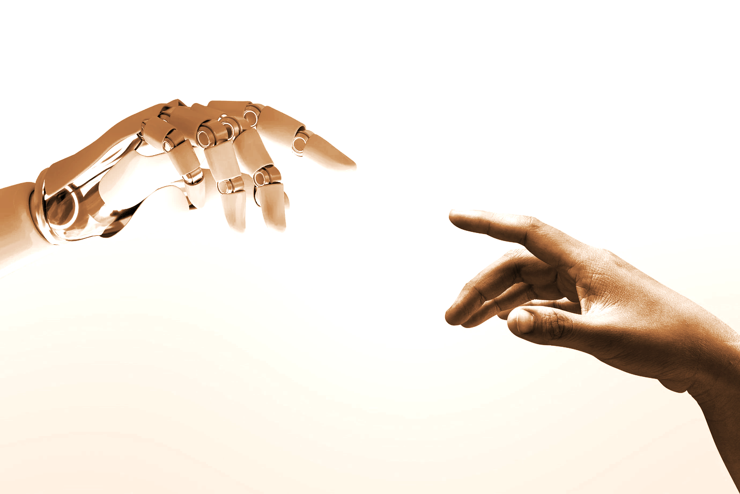


MACHINE LEARNING

Slide 2
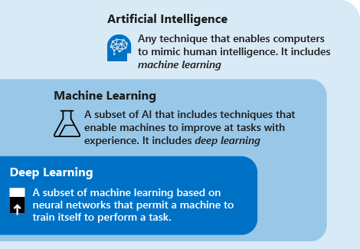
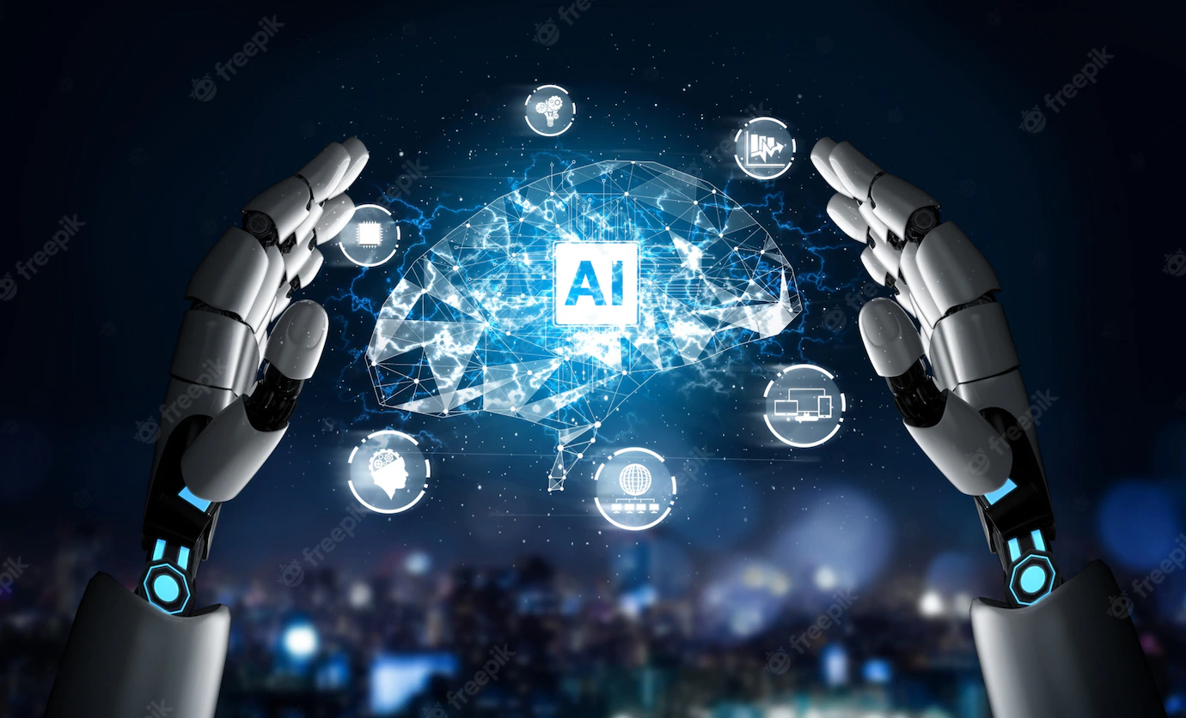
ARTIFICIAL INTELLIGENCE, MACHINE LEARNING AND DEEP LEARNING
Reference:
https://learn.microsoft.com/en-us/azure/machine-learning/concept-deep-learning-vs-machine-learning

Slide 3
ARTIFICIAL INTELLIGENCE (AI)
AI applications areas:
Transportation
Finance
Health Care
Social Media
Home
Law Enforcement

Slide 4
ETHICS OF AI
Accountability | Be responsible for the decisions taken by AI and its consequences.
Fairness | Ensure there is no discrimination based on gender, race, or caste
Privacy | Ensure the safety of privacy of the users
Respect for human values | Ensure the sensitivity to different cultural norms and values.
Transparency | Ensure that humans can easily understand its decision-making process.

Slide 5
Methods of Machine Learning
Supervised Machine Learning
Unsupervised Machine Learning
Semi-supervised Machine Learning
Reinforcement Learning

Slide 6
Methods of Machine Learning
Supervised Machine Learning
Train a machine (computer system) on labeled datasets (which includes the input data and corresponding output data).
Machine predicts outputs based on the provided training.
Types:
Classification - classify what the output is.
Regression - predict continuous output variables.

Slide 7
Methods of Machine Learning
Unsupervised Machine Learning
Train a machine (computer system) on unlabeled datasets (which includes the input data but no corresponding output data).
Machine predicts outputs without any supervision.
Types:
Clustering - group the data into clusters based on parameters such as similarities or differences between the data.

Slide 8
Methods of Machine Learning
Semi-supervised Machine Learning
Train the model with the small amount of labeled training dataset (similar to supervised learning) until you get acceptable accuracy.
Use the trained model to predict the outputs the unlabeled training dataset. (The outputs are the pseudo labels - not accurate labels).
Use those pseudo labels in unlabeled training dataset.
Combine the labeled training dataset and pseudo labeled training dataset.
Train the model again to decrease the error and improve the model’s accuracy.

Slide 9
Methods of Machine Learning
Reinforcement Learning (RL)
The RL developers design the reward function for RL agents.
The model agent learns from its actions taken to generate rewards.
Find a way to maximize its reward.

Slide 10
Steps of Machine Learning
Data Collection
Data Preprocessing
Model Selection
Model Training
Model Evaluation
Parameter Tuning
Prediction with Model

